Slide 1

Affected User Analysis
By Karthik S

Slide 2
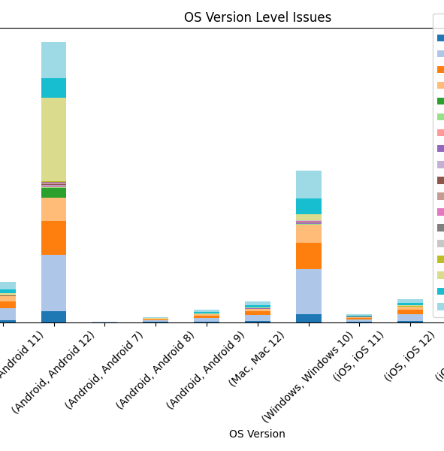
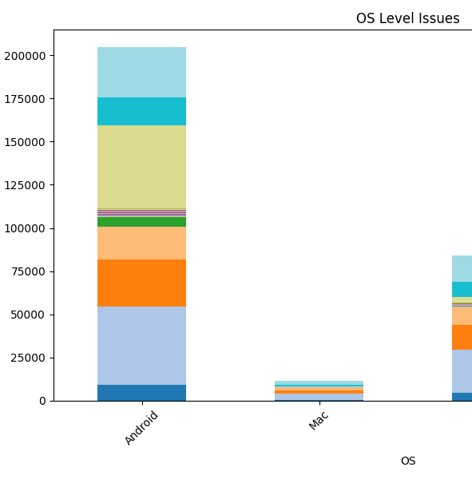
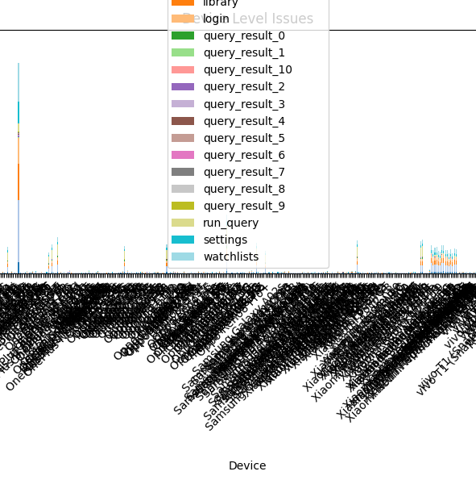
Stacked Bar Plots
Device Analysis is a little more clustered.
But the OS and OS version level analysis yields great results with emphasis on what issue affects which system the most

Slide 3
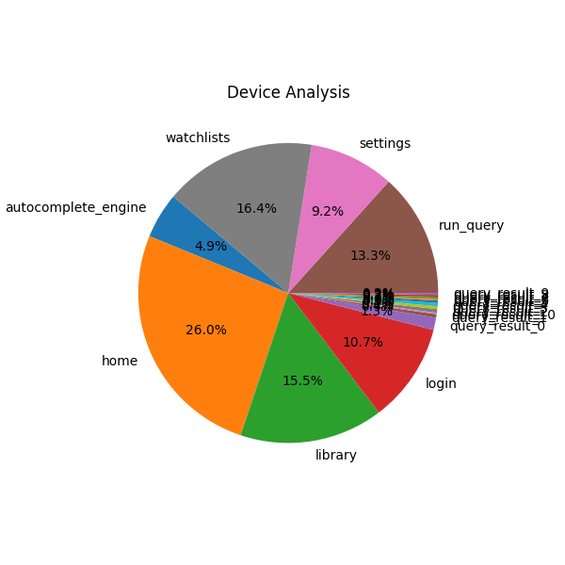
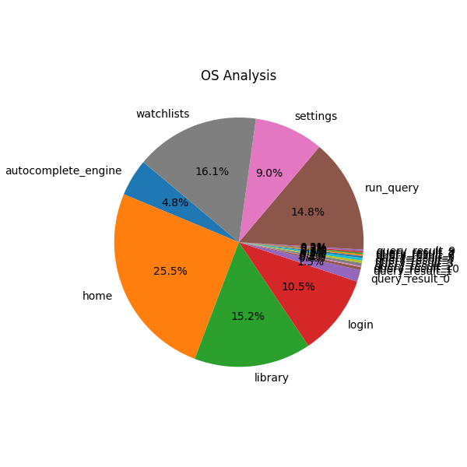

Pie Charts
OS and OS version Analysis is almost the same and better results are uncovered from device analysis.

